Slide 1
California Valley Solar Ranch Habitat Mitigation and Monitoring Plan Implementation
Presented by
Doug Drynan
November 4, 2016

Slide 2
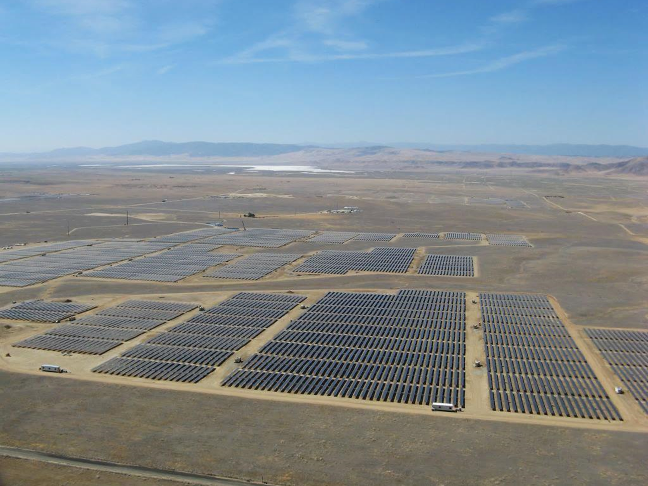
California Valley Solar Ranch (CVSR)
250-MW solar photovoltaic energy facility in California Valley
Required acquisition and permanent protection of habitat conservation lands for compensatory mitigation
Approx. 9,209 acres
Satisfies permit conditions of SLO County, CDFW, and USFWS

Slide 3
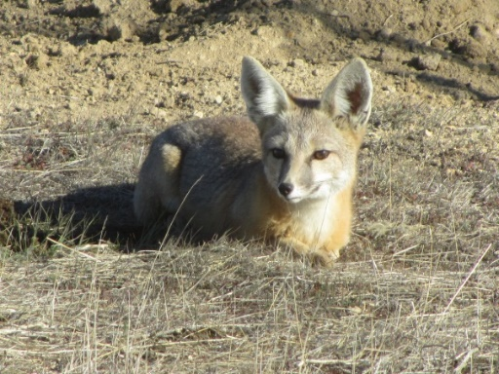
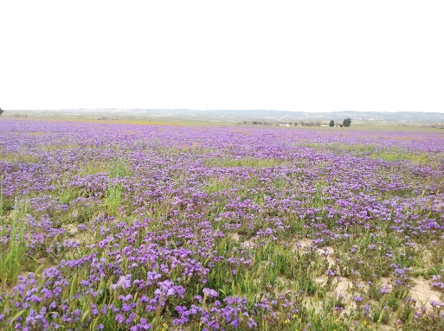
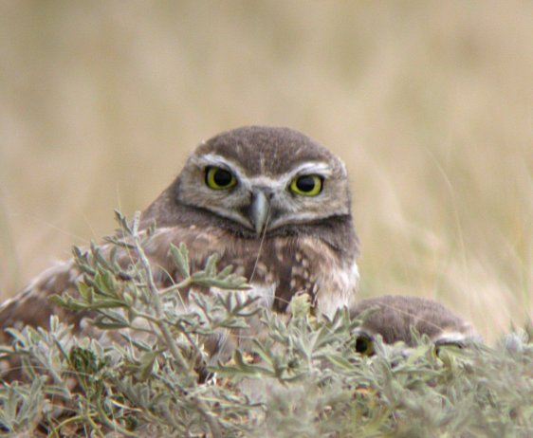
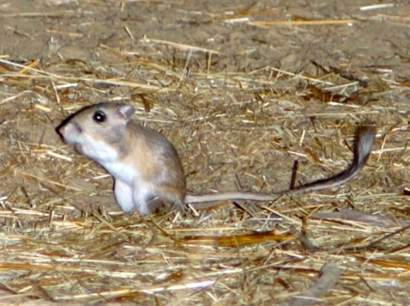
Goals
Conservation Lands
Mitigate for project impacts while supporting a regional strategy
for the conservation of a wide variety of native plants and animals, including species listed as threatened or endangered by the
State of California or United States
HMMP
Adaptive management strategy to preserve, enhance and maintain the conservation lands;
Specific management and monitoring goals and objectives
related to the maintenance or enhancement of habitat values for native plants and wildlife

Slide 4
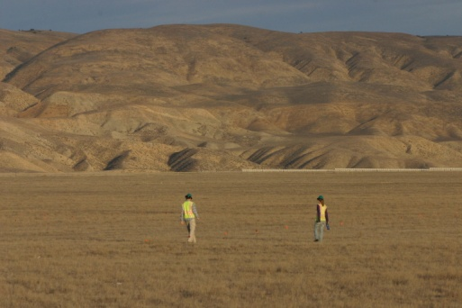
Organization
High Plains Ranch II is Project proponent
High Plains Ranch I and American Wind Capital are the land owners
H. T. Harvey & Associates serving as Conservation Lands Manager
CDFW is Easement Holder
National Fish and Wildlife Foundation is current Endowment Holder

Slide 5
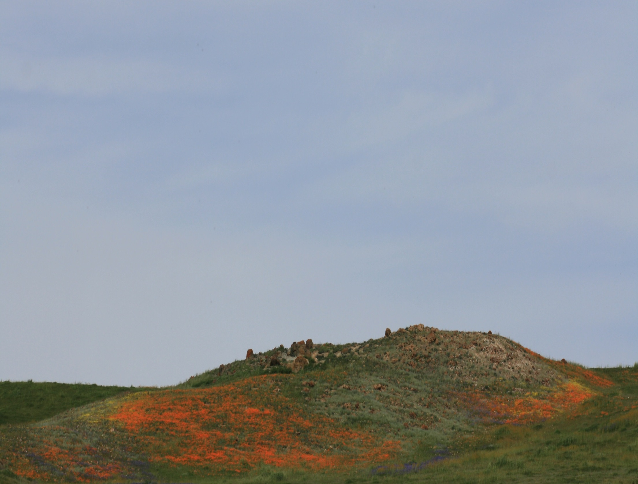
HMMP Elements
Special-status plants
Special-status wildlife
Plant communities
Invasive weeds
Vegetation management/
Grazing plan
Trash and trespass
Fire hazard reduction
Fencing and gates
Grazing infrastructure
Annual reporting
Work plan
Notes:
An Adaptive Aanagement Plan
Year 1 of the HMMP monitoring began in September 2011, and the year is defined through August of 2012.
We are currently in Year 6 of monitoring.

Slide 6
Onsite Conservation Lands
Approx. 3,333 acres surrounding the CVSR project
Identified in the HMMP as the CVSR Management Area or CVSR MA
Monitor annually at least 3 years (plants) and 5 years (wildlife) post-construction
Compare trends to Offsite Conservation Lands reference populations
Notes:
Conservation Lands recorded in phases or batches ahead of construction phases.
First onsite easements recorded in Nov 2011. Last in September 2015
After the initial post construction monitoring period, by Year 10, most monitoring intervals change to every 5 years in perpetuity

Slide 7
CVSR MA Batch 1
Notes:
protected in “batches” ahead of CVSR construction phases
Batch 1-2011

Slide 8
CVSR MA Batch 2
Notes:
2011-2012

Slide 9
CVSR MA Batch 3.5
Notes:
2012

Slide 10
CVSR MA Batch 5
Notes:
2015

Slide 11
CVSR MA 3,333 acres

Slide 12
Offsite Conservation Lands
North Carrizo Conservation Lands
4,043 ac near and around California Valley
South Carrizo Conservation Lands
1,834 ac surrounded by Carrizo Plain National Monument (CPNM)
Mosaic of connectivity between CVSR and CPNM
Notes:
First offsite easements recorded in Nov 2011. Last in December 2015

Slide 13
North Carrizo Conservation Lands 4,043 ac
Notes:
Include what's known as NC-17 parcels, which are the 2.5 acre California Valley Subdivision parcels, which create a mosaic of connectivity between the Onsite Conservation Lands and the other North Carrizo parcels

Slide 14
South Carrizo Conservation Lands 1,834 ac
Notes:
South of Soda Lake. Inholdings within and around Carrizo Plain National Monument

Slide 15
CVSR Conservation Lands part of a mosaic of protected lands in Carrizo Plain
Notes:
This slide shows all the Onsite, North Carrizo and South Carrizo Conservation Lands

Slide 16
CVSR Conservation Lands part of a mosaic of protected lands in Carrizo Plain
Notes:
Carrizo Plain National Monument

Slide 17
CVSR Conservation Lands part of a mosaic of protected lands in Carrizo Plain
Notes:
Carrizo Plain Ecological Reserve (CDFW)

Slide 18
CVSR Conservation Lands part of a mosaic of protected lands in Carrizo Plain
Notes:
Additional protected lands in North Carrizo related to solar sites

Slide 19
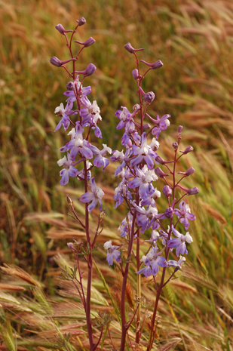
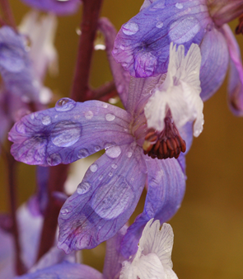
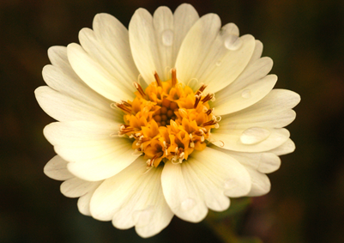
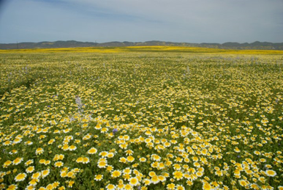
Rare Plant Monitoring
Species requiring mitigation:
Crownscale
Recurved larkspur
Ferris’ goldfields
Pale-yellow layia
Jared’s pepper grass
Baseline data collected 2010-2011
31 permanent monitoring transects established
Monitoring postponed in Year 3 (2014) due to drought
Year 4 surveys: higher precipitation in 2015 than 2013 increased vegetative cover
Additional rare plant species on Conservation Lands are preserved and monitored
Notes:
Baseline surveys produced a comprehensive inventory of special-status plant species against which future surveys compared
In general, most species of rare plants increased in absolute cover, density, and numbers of plants between 2013 and and 2015 monitoring.

Slide 20
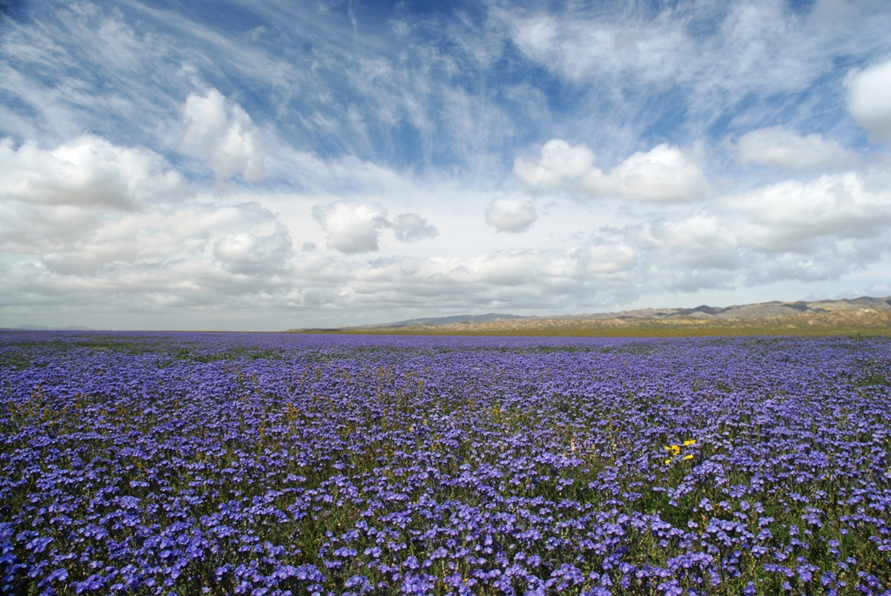
Rare Plant Results & Conclusions
Rare plants increased in absolute cover, density,
and numbers of plants between 2013 and 2015
For many species on many parcels, rare plants were more
prevalent in 2015 than during baseline surveys
Annual plants responded differently then perennials, which did not increase in 2015
These trends were observed both on the Conservation Lands and on reference transects

Slide 21
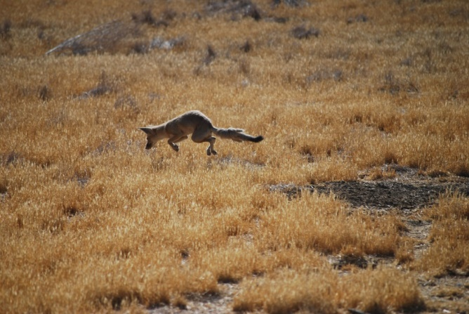
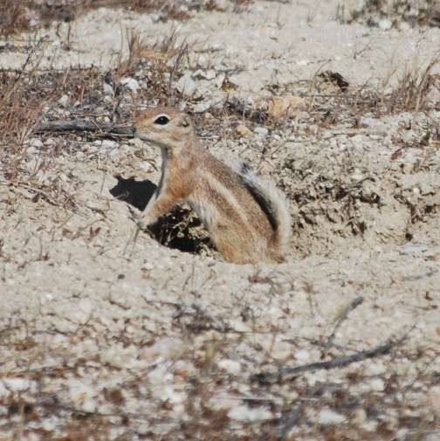
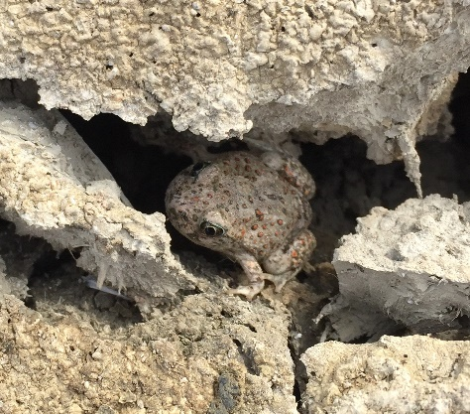
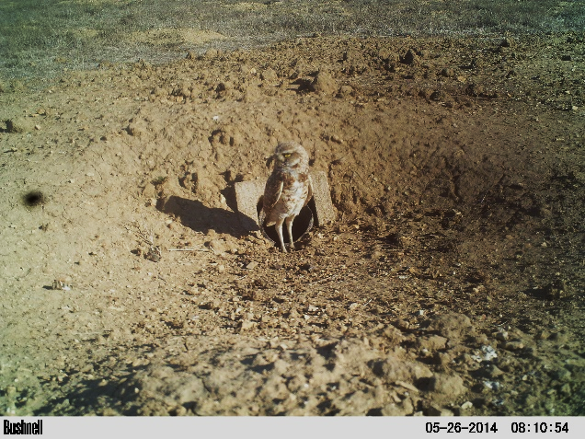
Wildlife Monitoring
Monitor populations of special-status species on Conservation Lands including:
San Joaquin kit fox (SJKF)
Giant kangaroo rat (GKR)
San Joaquin antelope squirrel (SJAS)
Burrowing owl
Western spadefoot

Slide 22
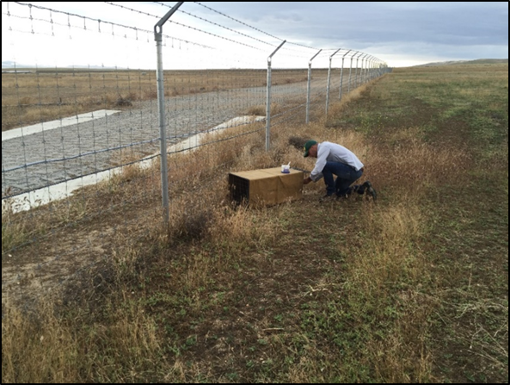
Monitoring Techniques
Mapping surveys for sign of GKR, SJKF, SJAS
Mark-recapture trapping for GKR
Radio telemetry study for SJKF (currently replaces spotlighting and camera stations)
Focused surveys for Burrowing owl and Western spadefoot
Notes:
A variety of monitoring techniques have been used over the six years of management of the Conservation Lands. Some techniques that were used during the initial years, such as spot lighting and camera stations, have been replaced by a radio telemetry study, required by the projects ITP. I present further details on GKR and SJKF monitoring in the following slides

Slide 23
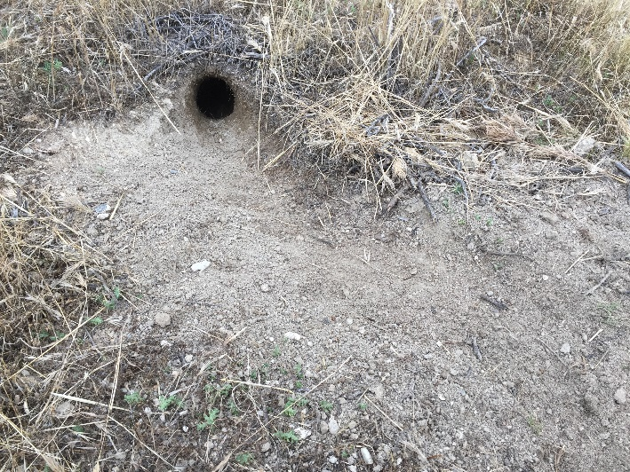
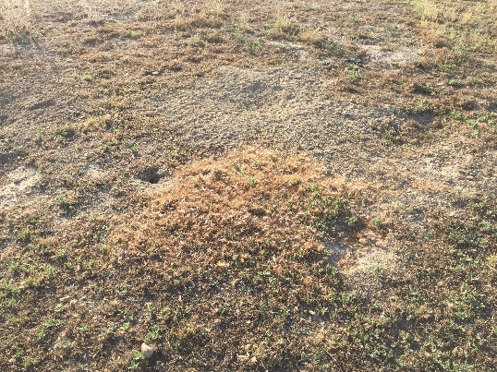
Giant Kangaroo Rat Precinct Mapping
Mapping surveys based on presence of sign
Relative index of the population over time
100% coverage surveys prior to 2014
In 2014 & 2016, subsampling of offsite parcels, full coverage of Onsite Conservation Lands where GKR occur
Notes:
Mapping surveys of GKR precincts based on presence of typical sign such as tracks, tail drags, scat, hay stacks, and suitable burrow openings
Starting in 2014, an approved sub-sampling method was applied, where 10 % of offsite North and South Carrizo Conservation Lands were mapped, and 100% of the onsite CVSR MA was mapped, where GKR occur.

Slide 24
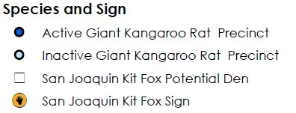
2014 GKR Distribution CVSR MA
Notes:
Maps are generated of the distribution of GKR precincts on the Conservation Lands. This map shows the onsite population as mapped in year 4 (fall 2014)

Slide 25
GKR Mark-recapture
Trapping grids
2 Onsite Conservation Land grids
2 South Carrizo CL grids as reference site
Trapping in spring and fall
Marked with PIT tags
M/F, weight, foot length, reproductive condition
Notes:
Trapping grids/sites had 100 traps each. A total of 1200 trap nights for onsite, and 1200 trap nights for south Carrizo reference site
Pit tags used to confirm re-captures

Slide 26
GKR Results & Conclusions
Year 4 General Trends
CVSR MA: 37% increase in density of precincts as compared to Year 2
North Carrizo Conservation Lands: 8% increase in density
South Carrizo Conservation Lands: 117% increase in density
Notes:
Picture is of a old relocation pen for GKR, showing fresh activity
Density over time trend calculated only for those parcels that were sampled in multiple years.
Year 1 and 2 data provide a baseline to compare general trends in population moving forward.
As expected, overall densities of giant kangaroo rat precincts were the highest on the South Carrizo Conservation Lands. These parcels are surrounded by the CPNM, where there is a dense giant kangaroo rat population. Results from Year 1 through Year 4 indicate a fluctuation in density estimates across all of the South Carrizo Conservation Lands, in which density decreased in Year 2 (2012-2013) but rose in Year 4 (2014-15).

Slide 27
GKR Results & Conclusions
Trends in populations reflect regional trends and likely as a result of prolonged drought
Decrease in precinct density detected in South Carrizo in year 2, but increasing by year 4
Year 6 mapping surveys are documenting an expansion of the onsite and North Carrizo populations
2011-2012
2014-2015
2012-2013
Notes:
Rainfall totals from the CDF station in the North Carrizo, where rainfall during the 2015-2016 rain year was slightly above the long term annual average of 10.06 inches. South Carrizo in 2016 still below normal (8.83)
Our results follow general regional trends
A long-term study of giant kangaroo rat populations in the CPNM, called the Carrizo Plain Ecosystem Project (CPEP), documented a steep decline in giant kangaroo rat abundance in 2013, with the lowest estimates of abundance ever recorded at one of the study sites, the Center Well pasture, since the study began in 2007 (Endicott 2014, Prugh et al. 2015). However, summer 2015 trapping data indicate that the study populations of giant kangaroo rats are recovering, with higher abundance and survival recorded (Prugh et al. 2015, Stafford pers. comm. 2015). Giant kangaroo rat populations are known to fluctuate substantially based on drought conditions and seed crop failure (Williams et al. 1993). At the CPEP study sites, plant species richness, vegetation percent cover, and cover by grass species were at extremely low levels in 2014 but increased dramatically in 2015 (Prugh et al. 2015).
Current data from year 6 surveys suggest this increasing density trend continues, with expansions of the onsite and north Carrizo populations, and stable or increasing south Carrizo populations.

Slide 28
GKR Preliminary Results Year 6 North Carrizo Conservation Lands
Notes:
GKR now occur in 7 North Carrizo Conservation Land parcels where they were not detected in sample grids during the Year 4 surveys.
Includes parcel NC-14 (Diefenderfer), an area where grassland restoration occurred in 2011

Slide 29
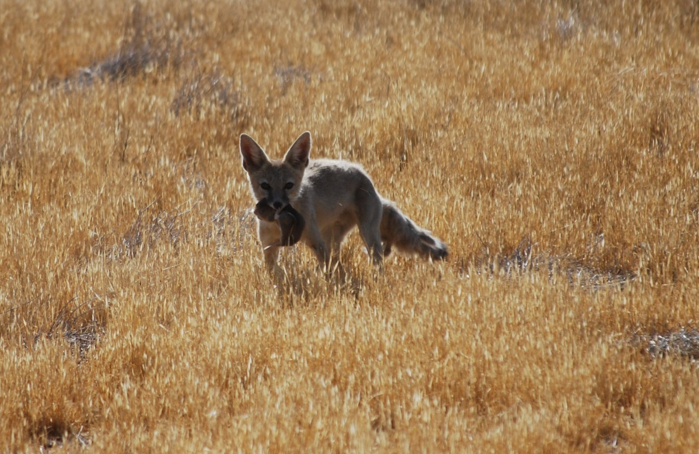
San Joaquin Kit Fox Monitoring
Mapping surveys provide incidental information on SJFK use of parcels
SJKF telemetry study monitors CVSR MA use by SJKF and provides detailed information on habitat use and home range size
Notes:
Mapping surveys provide some incidental information on SJKF use (such as observations of scat, or potential dens).
HMMP monitoring for SJKF revised in year 5. Spotlighting and camera stations were discontinued due to the limited information they provided on kit fox use, and instead the telemetry study using GPS collars, is now the primary technique used to monitor SJKF populations during HMMP Years 5-7; The study is a three year study required by the project ITP, that began in 2015, and will end in 2017.

Slide 30
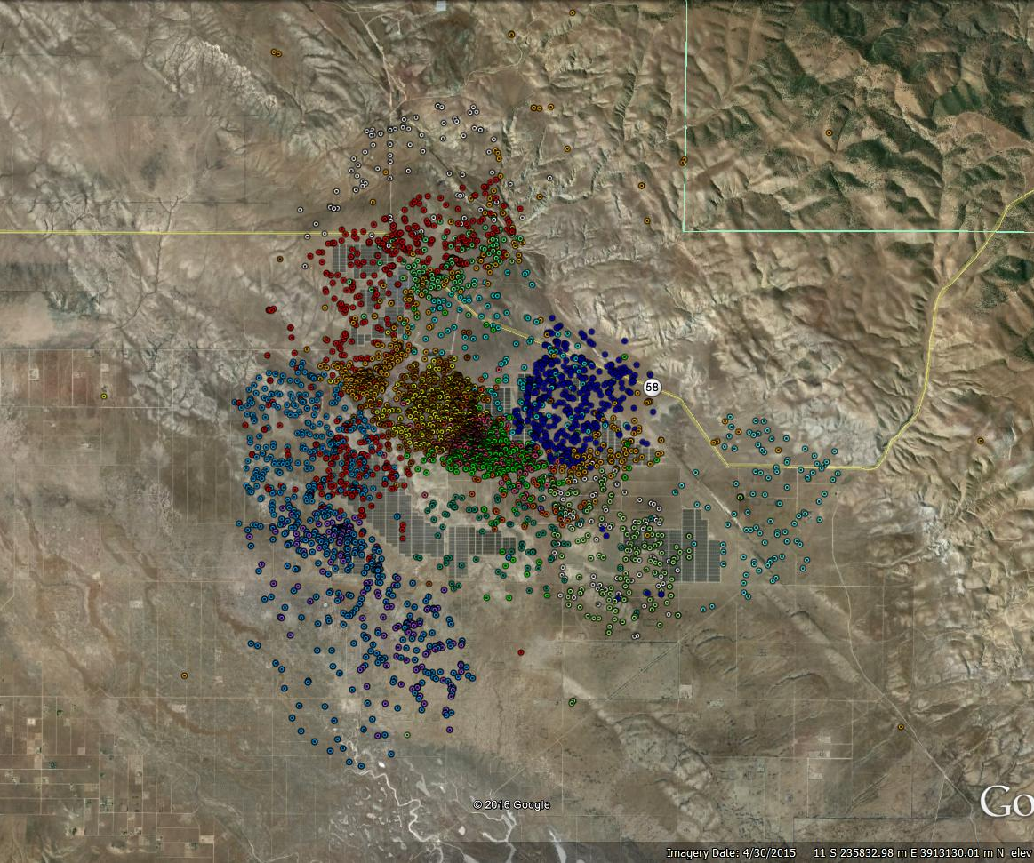
SJKF Telemetry Detections Onsite
During first year of study (2015) 22 animals were collared and tracked
10 animals part of the onsite study group, 12 animals in offsite reference site, south of CVSR
Habitat use and home range analysis will be completed
Notes:
Image is the location data from the GPS collars of 18 foxes that were tracked over the last 2 years. Different colors represent different animals.
Telemetry study designed to compare habitat use, reproduction, and mortality between foxes residing on the Project and surrounding Onsite Conservation Lands and a reference population in the northern Carrizo Plain. Currently, there are 10 collared foxes on the Project and Onsite Conservation Lands, and 9 on or around the North Carrizo Conservation Lands reference site.
Similar study at Topaz Solar Farm. Data collected in a standardized way between Topaz and CVSR study sites, to yield a robust data set for analysis.
During the first year of the study, 22 San Joaquin kit foxes were trapped, radio-collared, and tracked for the CVSR kit fox monitoring study. Each study animal was tracked for 23 to 373 days, depending on when it was captured or, when it moved into the area from TSF (if applicable) , and the number of days it survived postcapture. There were a total of 12 males and 10 females tracked. The sex ratio was fairly even for both study sites, with six males and four females at CVSR and six males and six females at the CPNM reference site.

Slide 31
SJKF Results & Conclusions
Stable or increasing SJKF use of North Carrizo and Onsite Conservation Lands
Detections of SJKF in South Carrizo Conservation Lands tracks regional trends
Notes:
it is estimated that approximately 14 individual foxes and between three and six breeding pairs used the 6.8-square-mile footprint (of the Project and Onsite Conservation Lands) during Year 4.
Detections of SJKF in South Carrizo decreased in Year 4. Similar decline detected in CDFW 2014 population estimate from spotlight surveys. The population estimate from the 2014 surveys was 65 animals, which is the lowest number since the surveys began in 2000 (Stafford et al. 2015). However, the 2015 surveys resulted in an estimate of 156 individuals, and most of these were observed on the northern Carrizo Plain (Stafford pers. comm. 2015).
At conclusion of telemetry study, and starting in Year 8, ecological scent-detection dogs will be used to monitor SJKF populations within the onsite and offsite Conservation Lands.

Slide 32
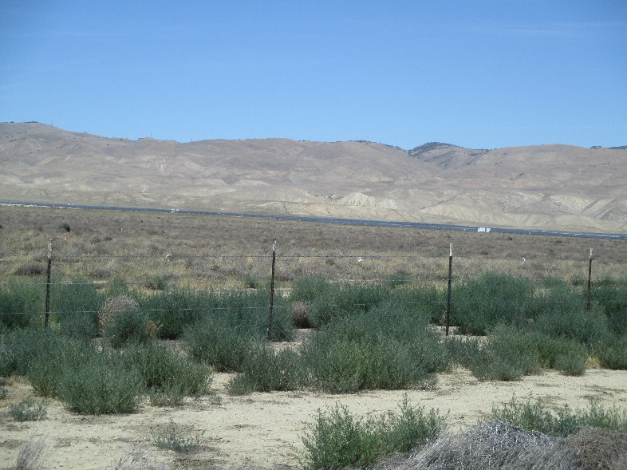
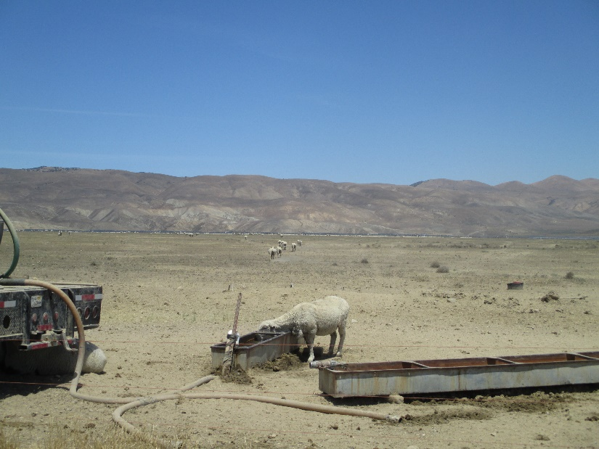
Weed Control and Grazing
Weed inspections and mapping
Pre- and post-emergent herbicides
Mechanical treatment (crushing/mowing)
Targeted sheep grazing occurred in CVSR MA in Year 5
Notes:
Weed such as: Russian thistle, London rocket, black mustard, perennial pepperweed, Russian knapweed
During Year 4 several larger infestations Russian thistle were treated within several areas of onsite and north Carrizo Conservation Lands. Through removal of dead plant material and application of preemergent herbicides. Other infestations were characterized by scattered, diffuse occurrences of Russian thistle.
widespread occurrence of Russian thistle is likely the result of ongoing drought conditions that have favored the establishment of this species over other annual grassland plants.
Russian thistle is commonly favored in drought conditions and declines in years with average or above-average rainfall (because it is outcompeted by other grassland plants). Because the prevalence of Russian thistle is likely to decline during non-drought years and because treatment of these plants would be expensive, logistically difficult, and have the potential to adversely affect wildlife resources (e.g., giant kangaroo rats) where herbicide spraying could occur, these areas were intentionally not targeted for treatment in 2014. Locations will continue to be monitored.
Grazing occurs under the direction of the Grazing Management Plan, where specific targets for Residual Dray Matter (RDM) informs grazing. During Year 4, only parcels NC-12 through NC-16 met the criteria for grazing, which occurred from May-June 2015. During Year 5, targeted areas of the onsite Conservation Lands were grazed by sheep from June through July, for the purpose of Russian thistle control.

Slide 33
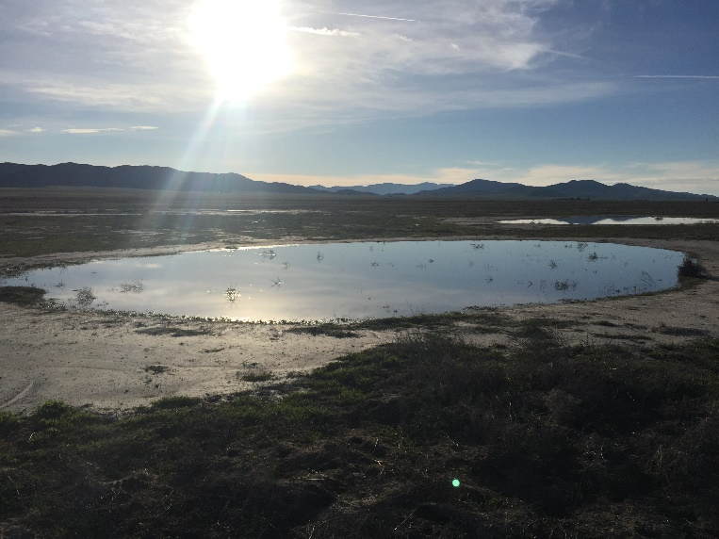
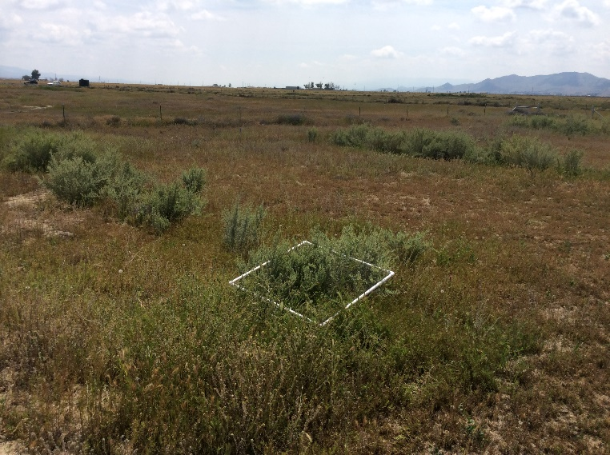
Habitat Restoration
Several restoration efforts occurring on Conservation Lands as required by the Projects permits:
Wetland restoration on NC-16; Created wetlands now support the federally endangered longhorn fairy shrimp
Grassland restoration occurred at several North Carrizo parcels, one of which (NC-14) now supports GKR
Pilot Shrub Study on several North Carrizo parcels to inform future efforts to restore shrublands to certain North Carrizo Conservation Land parcels
Notes:
Several habitat restoration efforts have occurred on the Conservation Lands, under the direction of separate Habitat Restoration and Revegetation Plans. Management and maintenance of these efforts do not occur under the direction of the HMMP.
Restored wetlands now support federally listed endangered fairy shrimp (Branchinecta longiantenna). Despite 4 years drought, met long-term success criteria
Parcels NC-12 through NC-16 were disked and seeded with a nurse crop of common barley in December 2011. Subsequently, a native grass species seed mix was aerially applied in late December 2011. Restored grassland habitat now supports populations of GKR; Despite 4 years drought, on track to meet long-term success criteria.
Pilot Shrub Study designed to evaluate different shrub planting techniques and investigate main variables associated with successful restoration of shrubland habitat. Results will be used determine the most appropriate site preparation techniques, target shrub species (if shrubland habitat is determined to be appropriate), and long-term success criteria

Slide 34
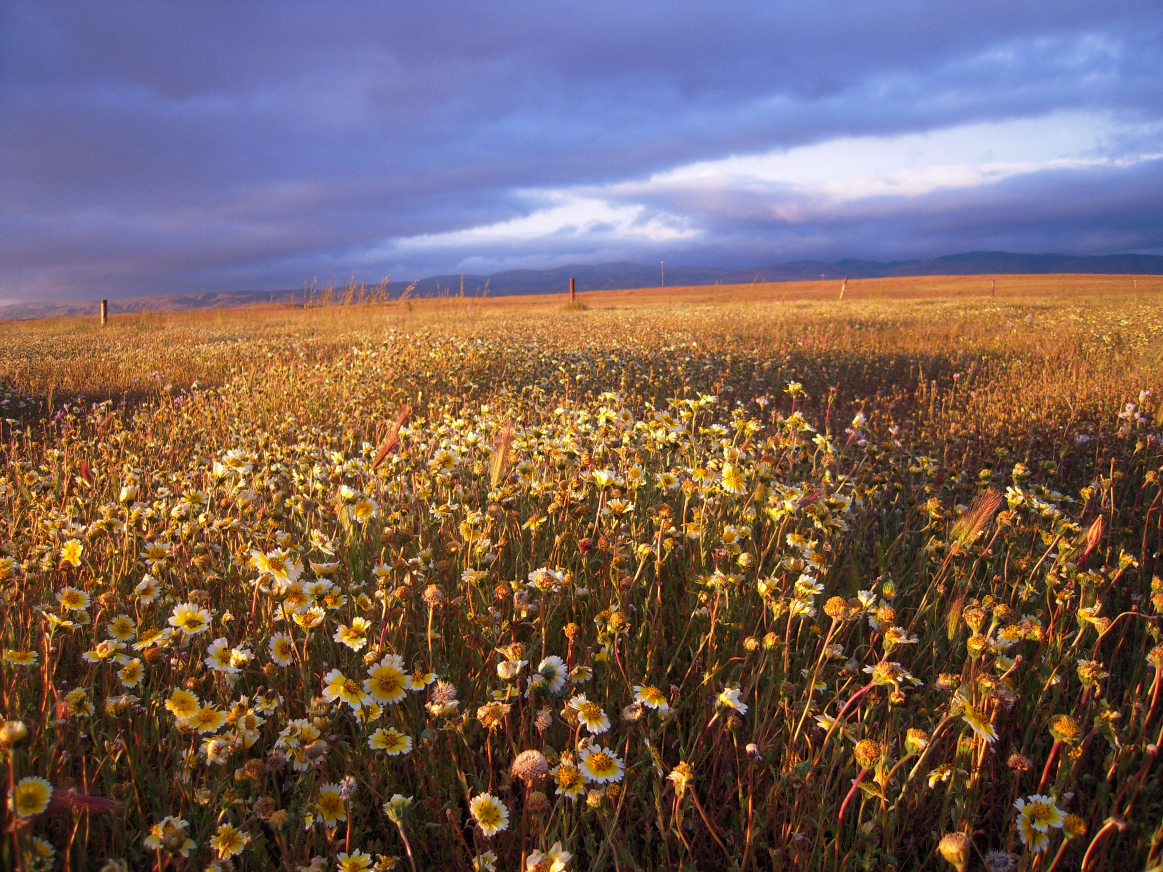
Questions?

