Slide 1
Creating Empowering Messages to Shift Human Culture
A psychological angle for approaching today’s environmental struggles.
Robert Gifford
Ecologistics – San Luis Obispo –October 22, 2016

Slide 2
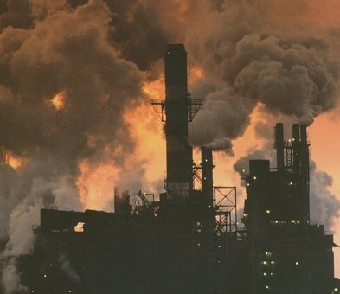
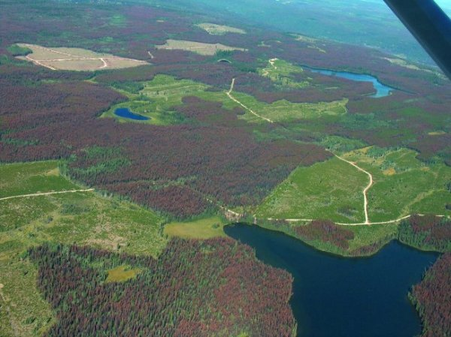
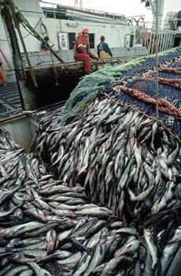
First, the problem
Environmental damage is inarguably anthropogenic,
at least to a significant degree.
Unsustainable behaviour,
however, is inarguably
an anthropogenic problem.
(Yes, volcanoes and earthquakes are also damaging, but we can’t prevent those.)
Notes:
If any of the studies I have described are of interest to you, I would be happy to discuss them with you during my visit, or by email later.
Now we turn to the main topics. In the rest of this presentation, I will refer to the problems of climate change and sustainability interchangeably. I do not mean to imply that the problems are exactly the same (though certainly they are related). However, most or all of the “dragons” I will discuss as hindrances to solving these problems are the same ones.
Although part of the changes to the climate may be natural, there is no doubt that human behavior is making it worse. The natural scientists tell us that big changes are ahead. What can a psychologist do to help?

Slide 3
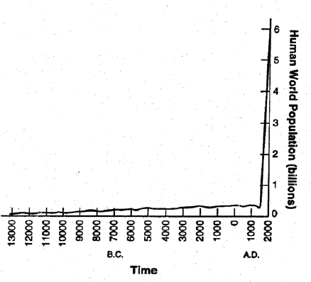
Second, population growth is a root cause

Slide 4
Climate change is, and will be, very serious
“There’s one issue that will define the contours of this century more dramatically than any other, and that is the urgent and growing threat of a changing climate.” Barack Obama, UN Climate Change Summit, September 23, 2014
“Climate change is the greatest collective challenge we face as a nation” – Justin Trudeau 2016

Slide 5
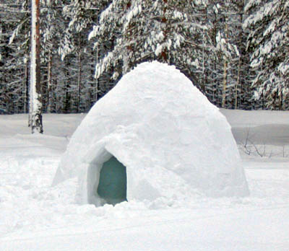
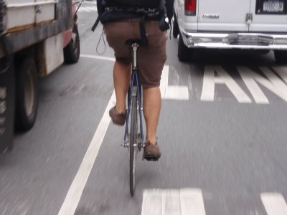
Sectoral causes of climate problems
Various structural-macro influences, including…
Geophysical factors (Can’t live without heat or A/C?)
Economic factors (Marketing, grow-or-die capitalism)
Technological factors (My ride is so comfy!)
Infrastructure problems (Ride a bike in traffic?)
Political constraints (Getting legislation passed is hard)

Slide 6
But ultimately, it’s about…Us
Psychological factors, broadly:
--Intrapersonal factors (personality, values, attitudes, skill, aspirations)
--Interpersonal relations (social comparison, trust, friendship, norms, etc.)
--Decision-making: Each one of us, every day,
citizen or CEO, makes choices every day,
and these choices matter in the aggregate
About half of all emissions are made by “us” – not industry, etc.

Slide 7
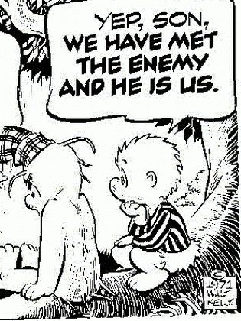
The guilty party
(This are Pogo, for you young ‘uns)

Slide 8
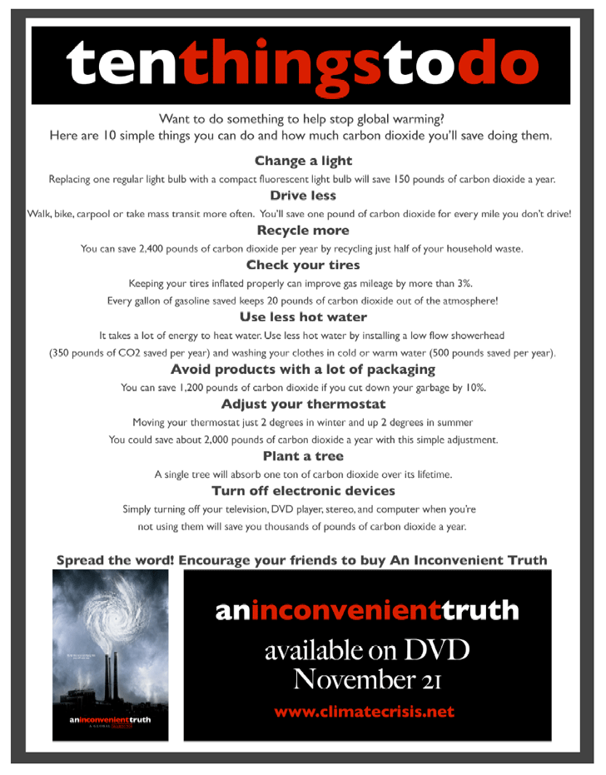
What to do? (These are from various websites)
Notes:
One proposed solution is to educate people about what they can do. This has already been done quite well, as these images from the internet show.
But are we all doing what we should? No.

Slide 9
“Man (sic) is not a rational animal, he (sic again) is a rationalizing animal.” Robert Heinlein, Assignment in Eternity (1953)
Unfortunately…

Slide 10
We don’t do (all) that we should (Not even all that we ourselves think we should!)
Why not? This is the key question
The Dragons of Inaction
Notes:
If we know what we should do, but we do not do that, why? This has been my primary interest in environmental psychology recently. I began to think about the reasons for this when journalists asked me this question: “Why don’t people act better, when they know better?”
Slowly I have developed these 1o answers to that question. So far this is more of a “thought exercise” than a formal study, but we have recently begun to gather data about the frequency of each obstacle, barrier, excuse, or “dragon of non-sustainability” as I like to call them.

Slide 11
Seven dragon genera (Incorporating 36 species in all)
Limited Cognition
Ideologies
Other People
Sunk Costs
Discredence
Perceived Risks
Limited Behavior
(For details see: “The Dragons of Inaction” in American Psychologist, 2011)

Slide 12
So, what can we do?
Identify the chief dragons for specific groups
Which are easiest, cheapest to overcome?
Which simply are not going to change?
Which messages and incentives work?

Slide 13
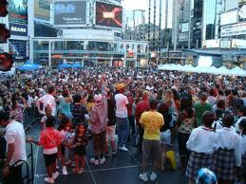
Seven ways to slay dragons: 1
Develop understanding of impactful behaviors
What exactly do people do? Measure behavior
Which are the most impactful acts?
Assess the variations in the rates of these actions
Discover the antecedents of these actions

Slide 14
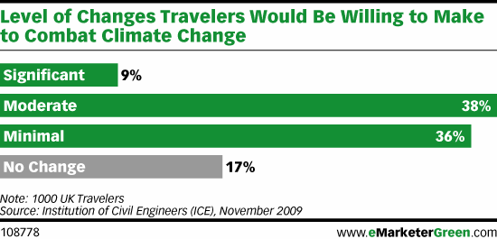
Seven ways to slay dragons: 2
Develop and evaluate interventions
Test information campaigns
Explore most effective forms of communication
Human factors for making good choices attractive

Slide 15
Seven ways to slay dragons: 3
Work with Other Disciplines
…for example:
Better energy-use meters (engineers)
Zero-energy buildings (architects)
Green communities (urban planners)

Slide 16
Seven ways to slay dragons: 4
Make Environment “Now” (because it is)
-- Community-based (network) diffusion
-- Facilitate amateur scientists
-- Develop social networks

Slide 17
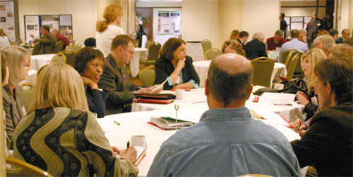
Seven ways to slay dragons: 5
Join the Policy Development Process
-- Not at the table = Not in the policy
-- Choose your comfort level: Organizational,
neighborhood, municipal, regional,
state, federal—but do get involved!

Slide 18
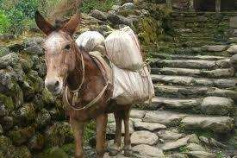
Seven Ways to Slay Dragons: 6 Reward Mules
Hey…we’re doing all we can!

Slide 19
Seven ways to slay dragons: 7 Reward Honeybees
Much climate-positive behavior is NOT done to help the environment, e.g.,
Voluntary simplicity
The bottom billion
Childless by choice
Cycling for health
Insulating to save money
Honeybees are helping, even if they are not on board the climate wagon! Reward them!

Slide 20
“Physician, heal thyself!”

Slide 21
Oh yes…Messages
First, the duds:
Fear: not so much
Sacrifice: not so much
Problem: not so much
Distant problems: not so much

Slide 22
Better messages, part 1
Public health issue
Empowerment
Solutions
Stories of everyday people succeeding: agency
Local issue
Concrete actions

Slide 23
Better messages, part 2
Social norms
A security issue
A moral issue
An economic issue
Visual messages
non-threatening,
local, everyday concerns
BUT…

Slide 24
Duh…people vary!
Wealthy, middle, and poor
Left-Right politics
Level of concern: 6 Americas
Values: which are tops?
Money, health, family, independence…
Example: Conservatives (purity)

Slide 25
We, and policymakers, should:
✓ Emphasize climate change as a present, local, and personal risk
✓ Facilitate more affective and experiential engagement
✓ Leverage relevant social group norms
✓ Frame policy solutions in terms of gains from immediate action
✓ Appeal to intrinsically valued long-term environmental goals and outcomes

Slide 26
That’s all folks…
Thanks for your attention…your thoughts?
Later?
Robert Gifford
University of Victoria
rgifford@uvic.ca
web.uvic.ca/~esplab/

